Slide 1

Mindframe
Case studies and tasks for public relations students
Notes:
Welcome to today’s tutorial on applying the Mindframe guidelines

Slide 2
Contents
Case Study 1: Tragic loss of a football star (slides 5-8)
Case Study 2: LGBTQA+ health and wellbeing data analysis (slides 9-12)
Case Study 3: Opening of new supervised injecting facility (slides 13-16)
Content advice: Some case study elements include fictional examples of unsafe communication, including discussion of suicide method and location.
Notes:
Teaching notes:
These case studies are designed to give students some practice in considering issues associated with reporting or communicating about mental illness, suicide and AOD so they will be better prepared to deal with such a situation, should it arise, when they are working as journalists. These are very sensitive and complex issues, and it is natural that some people may feel uncomfortable talking about them. Usually, these feelings are temporary and do not cause ongoing distress. Talking about mental illness or suicide in an educational and supportive environment provides lecturers with an opportunity to advise students about counselling and other services available on campus, and to encourage students experiencing problems to seek professional help by talking to a GP, health professional or call a crisis counselling service.
Use the series of questions as a guide to working through the scenario from a journalistic point of view. You may choose to have students work through each of these questions, or focus on specific questions relevant to a particular task or topic. For each of the tasks, it will be helpful to provide students with a copy of the educator resources at https://mindframemedia.imgix.net/assets/src/uploads/Mindframe_PRStudents.pdf

Slide 3
Self-care
During and following this session:
We will be discussing suicide, mental health concerns and alcohol and other drugs throughout this session.
At times, topics such as these can be distressing for some people.
Having a self-care action plan can be helpful.
This could include:
Talking to your lecturer, tutor or a university counsellor.
Talking to your GP or calling a counselling service such as Lifeline on 13 11 14.
Further self-care tips can be found in the resource Communicating about suicide, mental health and alcohol and other drugs resource distributed prior to this session.
Additional help-seeking information will be shared at the end of this session.

Slide 4
Discussion guidance
Creating a supportive environment:
Drawing on the Discussing sensitive issues: A guide for educators using Mindframe resources, establish a set of rules for the class discussion.
You could either do this in advance and include some dot points on this slide, or you could workshop and document an agreed set of rules at the commencement of the session.
See page 4 of the guide for further details.
Notes:
https://mindframemedia.imgix.net/assets/src/uploads/Mindframe_Educators.pdf

Slide 5
Case Study 1: Tragic loss of a football star
Summary:
Well-known football star Matt Devine has died by suicide.
The 24-year-old was a well-liked player and had been actively involved in fundraising activities.
He occasionally appeared on TV to speak both about his career on the field and his mental health concerns.
Matt went missing for a week before his body was recovered by police.
His death has deeply saddened the community and prompted calls for action.

Slide 6
Case Study 1: Tragic loss of a football star
Approach Task One (slide 7) and Task Two (slide 8) using the
following downloadable CS1 supporting materials:
News item: State Police brief on locating a body.
Example media release and news items for reference.
- Paul Green memorial (football club statement)
- Kyle White dead at 53 (news article)
- Wally Lewis probable CTE diagnosis (news article).
Statement from the fictional player’s family.

Slide 7
Task One: Group Discussion Activity
Once familiar with Case Study 1, students are to discuss the
following questions:
What were some of the key points made in the case studies?
Should your organisation speak on this incident/update?
If yes, who will your key stakeholders and publics be?
What key messages would you share?
What considerations around language and framing choices
can be made to minimise any risk of stigma or harm to audiences and loved ones?
How would you manage social media responses to the story?

Slide 8
Task two: Individual activity
Once familiar with Case Study 1, students are to draft a
press release from Matt Devine’s football club.

Slide 9
Case Study 2: LGBTQA+ health and wellbeing data analysis
Summary:
Following the release of the Rainbow Realities report, it
is noted that interpersonal connection, support, and engagement with the LGBTQA+ community can potentially serve as protective factors against poorer mental health
and wellbeing.
The report also revealed that psychological distress, subjective wellbeing, suicidality, self-harm, and support-seeking amongst LGBTQA+ populations reflect the negative mental health impacts of discrimination and marginalisation experienced
in Australia.

Slide 10
Case Study 2: LGBTQA+ health and wellbeing data analysis
Approach Task One (slide 11) and Task Two (slide 12) using the following downloadable CS2 supporting materials:
Rainbow Realities report summary and link to full report.
Audio: Interview with a LGBTQA+ advocate.
Transcript: Interview with a LGBTQA+ advocate.
Example social media content from LGBTIQ+ Health Australia (for reference).

Slide 11
Task One: Group Discussion Activity
Once familiar with Case Study 2, students are to discuss the
following questions:
What were some of the key points made in the case studies?
Should your organisation speak on this incident/update?
If yes, who will your key stakeholders and publics be?
What key messages would you share?
What considerations around language and framing choices
can be made to minimise any risk of stigma or harm to audiences and loved ones?
How would you manage social media responses to the story?

Slide 12
Task two: Individual activity
Once familiar with Case Study 2, students are to highlight one chapter from the report and prepare a social media statement or piece of content from the POV of a local LGBTIQ+ Health agency.

Slide 13
Case study 3: Opening of a supervised injecting facility
Summary:
A new supervised injecting facility has launched in Sydney, despite 12 months of petitions and community protest rallies opposing it.
Local alcohol and other drug (AOD) services, and three local churches were very much in support of the need for the service. One religious leader has sent a letter to the local government praising the new facility.
A community member has published an open letter opposing the centre citing potential negative impacts for locals in the area.

Slide 14
Case study 3: Opening of a supervised injecting facility
Approach Task One (slide 15) and Task Two (slide 16) using
the following downloadable CS3 supplementary materials:
A letter from a community member who is opposed to the facility’s opening.
A letter from a local church leader, who is supportive of
the facility.
UNSW news article about a real injecting facility
(for reference).
A Department of Health review of a real injecting facility
(for reference).

Slide 15
Task One: Group Discussion Activity
Once familiar with Case Study 3, students are to discuss the
following questions:
What were some of the key points made in the case studies?
Should your organisation speak on this incident/update?
If yes, who will your key stakeholders and publics be?
What key messages would you share?
What considerations around language and framing choices
can be made to minimise any risk of stigma or harm to audiences and loved ones?
How would you manage social media responses to the story?

Slide 16
Task two: Individual activity
Once familiar with Case Study 3, each student is to imagine they work in a public relations role for the local council.
Using the supporting materials, students are to then draft a speaker’s briefing for the mayor to use in their public remarks.

Slide 17
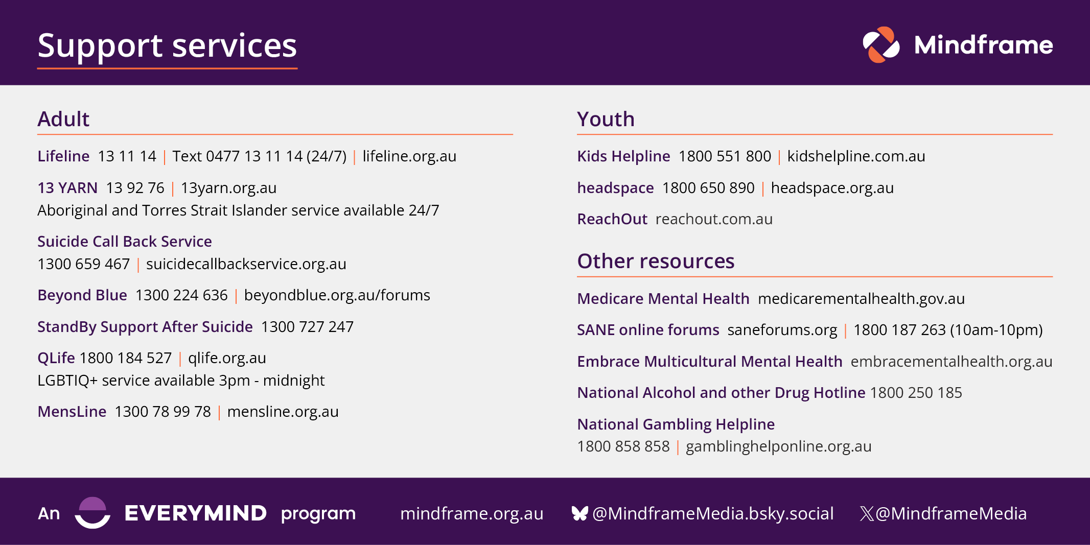
Help-seeking information

